Slide 1
CONNECTING TO STUDENT LIFE
Chapter 5

Slide 2
CHAPTER OBJECTIVES
Explore Student Life resources at Louisiana Tech
Understand multicultural competence and recognize opportunities for cultural diversity
Access information about organizations, events, and activities
Identify sources for recreation, health and wellness, counseling, career, and dining services

Slide 3
“We want you to get involved, enjoy your freshman year, develop as a person, and pursue academic excellence.”
SAM SPEED
Assistant Vice President for Student Advancement

Slide 4

CULTURAL COMPETENCE
What is diversity and why is it important?
Diversity encompasses race, ethnicity, sexual orientation, religion, socio-economic status, age, interest, differing abilities, and more!
Eight Reasons Why Diversity Matters in a University Setting (Hyman and Jacobs, 2009)
Expands Worldliness
Enhances Social Development
Prepares for Future Career Success
Increases Knowledge Base
Promotes Creative Thinking
Enriches Multiple Perspectives
Prepares for Work in a Global Society
Enhances Self-Awareness

Slide 5


DIVERSITY AT LOUISIANA TECH
The Bulldog Success Center and the International Student Office provide warm, welcoming, encouraging, and inclusive environments for students, faculty, and staff ,

Slide 6

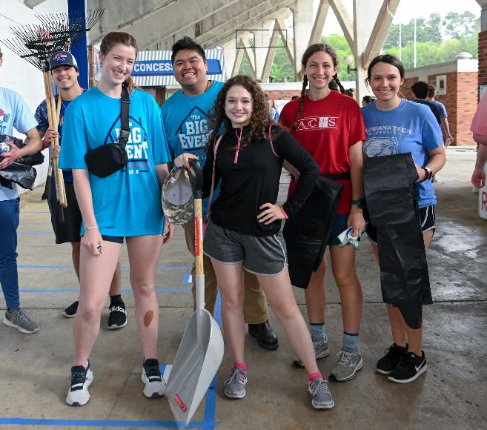
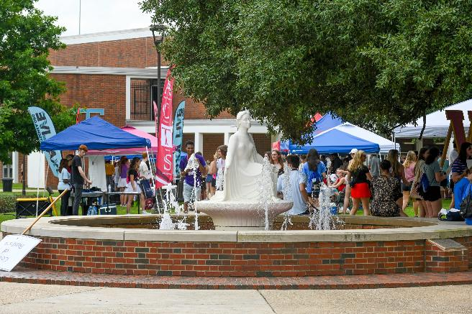
LOUISIANA TECH STUDENT ORGANIZATIONS
Over 160 Student Organizations Encompassing:
Service Organizations
Religious Groups
Sorority/Fraternities
Special Interest Groups
Professional Associations
Honor Societies
Student Government

Slide 7
STUDENT RESOURCES
There are a lot resources around campus designed to help you connect and have a great college experience. What resources do you already know about?

Slide 8
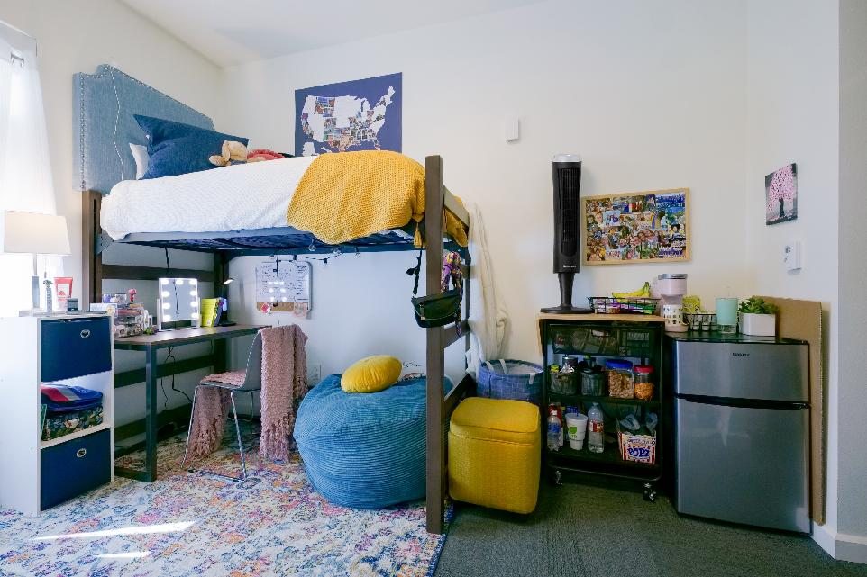
RESIDENTIAL LIFE
Perks to living on-campus:
Resident parking keeps you close to your classes, recreation, and more
Variety of housing options to fit every budget and preference.
Resident Assistants help foster connection through community events and provide the support necessary to have a great living experience.
Wyly Tower 202
318.257.4917
housing@latech.edu

Slide 9
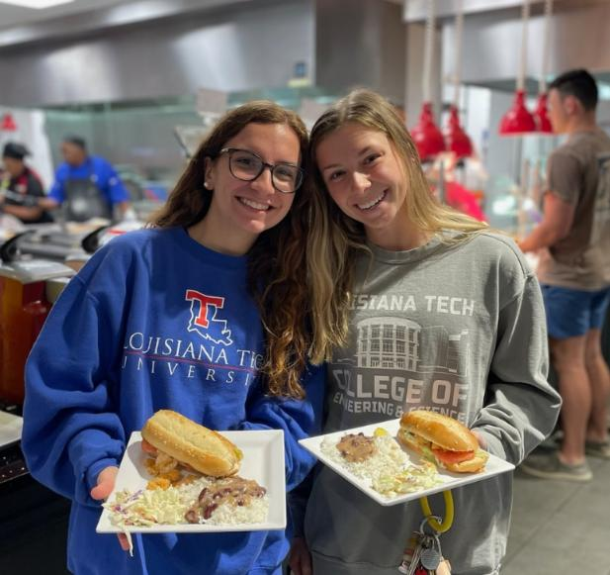


CAMPUS DINING
On-Campus Dining Locations:
The Tech Table
Chick-fil-A
Subway
Moe’s Southwest Grill
Sushic
Starbucks
Quick Eats – Richardson Hall, Tolliver Hall, College of Business

Slide 10
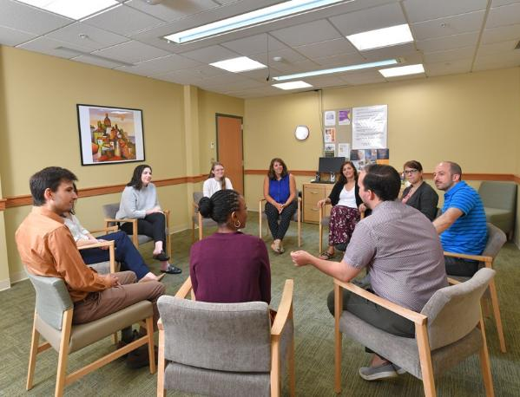

COUNSELING SERVICES
SERVICES OFFERED:
Individual Counseling
Group Counseling
Crisis Intervention
Ethics Training
Medication Management
Smart HABITS Academy
Alcohol & Other Drug Education
Keeny Hall 310
318.257.2488
counseling@latech.edu

Slide 11

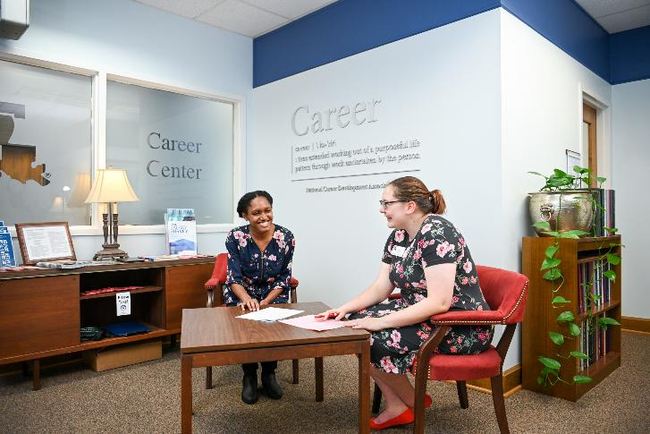
CAREER CENTER
SERVICES OFFERED:
Job Exploration Services
Career Preparation Seminars
Resume Reviews
Professional Dining Etiquette
Handshake Career Platform
Career Fairs
Career-Planning Courses (COUN 200 & 303)
Career Library
On-Campus Interview Spaces
Keeny Hall 337
318.257.4336
careercenter@latech.edu

Slide 12

TESTING & DISABILITY SERVICES
SERVICES OFFERED:
Standardized Testing Services
CLEP Credit Exams
Major Field Exams
Liaison assisting students with qualifying disabilities in working with faculty, staff, and community agencies.
Available accommodations for eligible students include:
Extended time on tests/assignments, distraction-reduced environments, consideration for classroom breaks, preferred seating, and assistance with notes.
Wyly Tower 318
318.257.2969
tds@latech.edu

Slide 13

INTERNATIONAL STUDENT OFFICE
SERVICES OFFERED:
International Picnics, International Scholarship Dinner, Cultural Festivals, and more.
International Recruitment and Admissions
International Student Orientation
Assisting ISO students in applying for social security cards, driver’s licenses, and ID cards
Resource for cultural information
Student Ambassador Programs
Dessert Social
Coffee Hour Fridays
Seminars and workshops
Back of Tolliver Hall
318.257.4321
iso@latech.edu

Slide 14


BARNES & NOBLE BOOKSTORE
SERVICES OFFERED:
Bulldog Bundle - $23 / credit hour
Opt in/out within first 7 class days.
Textbook purchases and rentals
Purchase Scantrons
School supplies
Licensed Tech Gear
Graduation Regalia
Graduation Class Rings
VIP Events & Sales
Barnes & Noble Building (exterior Quad)
318.257.3066

Slide 15
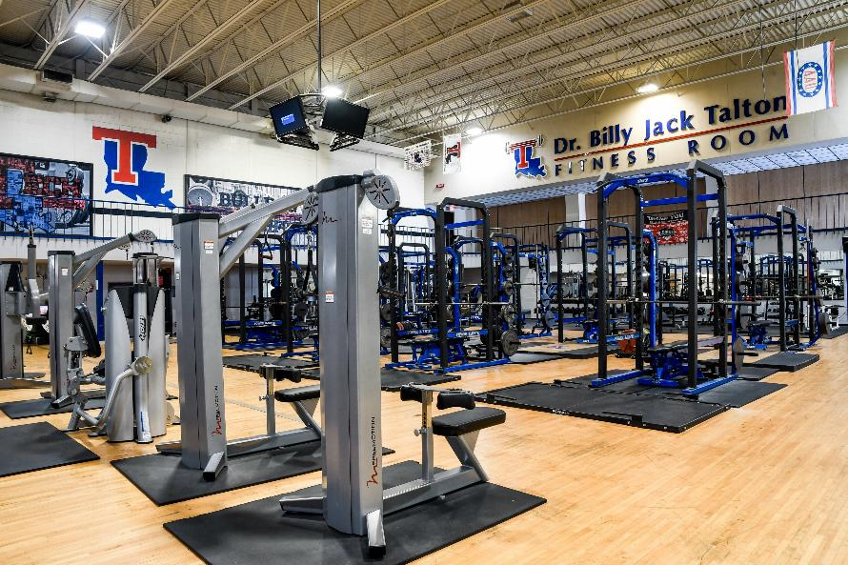
RECREATION SERVICES
SERVICES OFFERED:
Intramural Sports each quarter
Club Sports
Aerobics, Group Workouts, and Spin Classes
Fitness Assessments
Personal Training
7.5 Acre Park with Running Trails, Picnic Tables, Pavilions, and a Frisbee Golf Course
Indoor Rock Wall
6 – Lane Bowling Alley
6 Full-Size Basketball Courts
Indoor/Outdoor Pool
Billiards
Racquetball Courts
Ping Pong Tables
Two fitness areas
Lambright Sports & Wellness Center
318.257.4634

Slide 16



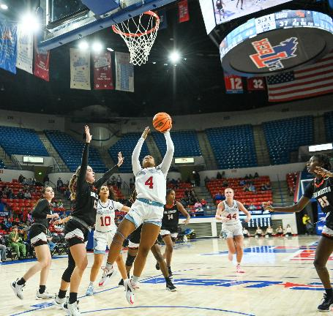
ATHLETICS
Member of Conference USA (CUSA)
Year-round Sports
Free Admission to All Home, Regular Season Sporting Event
Louisiana Tech Athletics App
Numerous Post-Season Appearances including 6 National Championships (Football – Div II & Women’s Basketball – Div. I)
Full NCAA Division I Participating Sports:
Baseball / Softball
Men’s & Women’s Basketball
Track & Field
Cross Country
Bowling (Women)
Soccer (Women)
Tennis (Women)
Golf (Men)
Football
Volleyball (Women)

Slide 17
MAKING HEALTHY DECISIONS
Chapter 8

Slide 18
CHAPTER OBJECTIVES
Understand the safety resources available on campus
Articulate tips and strategies for maintaining personal safety and protection
Define and recognize hazing and harassment
Demonstrate effective choices for physical wellness

Slide 19

There are many choices and decisions you will have to make in college. What (or who) will guide you and impact those decisions?

Slide 20
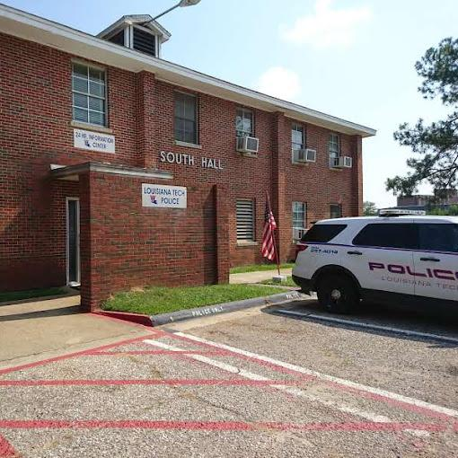
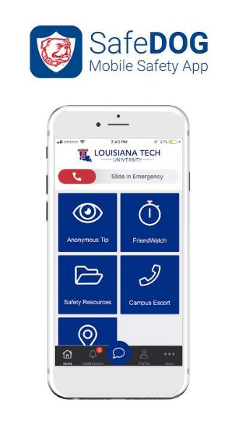
SAFETY, SECURITY, AND SUPPORT
Being protected, safe, and supported while on campus is everyone’s responsibility. The University Police, the faculty and administration, counseling services, and many more are actively working to ensure your safety. But let’s not forget that you must play a part yourself.
TIPS TO HELP WITH SAFETY AND CRIME PREVENTION:
Be alert and pay attention.
Utilize golf cart escort service – 318.257.4018
Lock the doors to your car and residence
Report suspicious activity
Download the Safe Dog App

Slide 21

THE SAFE DOG APP
Available on Android and iPhone
Send in Anonymous Tips
FriendWatch tracker
Easily call campus police
Request Escort Services

Slide 22

HAZING & HARASSMENT
HAZING
Any activity expected of someone joining or participating in a group that humiliates, degrades, abuses, or endangers them regardless of a person’s willingness to participate.
Hazing is against state law (RS 17:1801) and campus policy. Hazing is not tolerated by Louisiana Tech University and student training is required.

Slide 23

HAZING & HARASSMENT
HARASSMENT
Unwanted and unwelcome conduct directed against a person based on one or more of a person’s protected characteristics or status which is so severe or pervasive that it creates an intimidating, hostile, or offensive environment.
May be Physical, Verbal, or Non-Verbal
Stalking
Sexual Harassment
Cyber-Bullying
If you or someone you know is impacted by harassment on campus, contact the Title IX Office in Wyly Tower 1526.

Slide 24
SEXUAL HEALTH
Although a natural and functional part of life, it can also lead to:
Unwanted pregnancy
Sexually Transmitted Infections (STI’s)
Emotional Consequences
Deciding to engage in sexual activity should not be taken lightly. Be sure to consider:
Abstinence – choosing to not be sexually active
Monogamy – being sexually exclusive
Education – making informed decisions
Communication – define comfort levels and precautions
Protection – use a condom
Vaccination – protect yourself against HPV and Hepatitis
Screening – getting tested and seeing your physician regularly

Slide 25
SEXUAL VIOLENCE
This next slide will include statistics and information on sexual assault and rape. If you are not comfortable with this topic, please feel free to step outside of the classroom.
If you or someone you know have been impacted by sexual assault, please utilize campus resources such as:
The Counseling Center (free and confidential) – 318.257.2488
Campus Police – 318.257.4018
National Sexual Assault Hotline – 800.656.HOPE
National Coalition Against Domestic Violence – hopeline.com

Slide 26
SEXUAL VIOLENCE
Sexual assault and rape are real threats that college students face. 13% of college students and 1 in 5 college women experience rape or sexual assault at some point. (RAINN.ORG)
80% of assaults go unreported, with alcohol and drugs playing large roles in a majority of reported assaults. Follow these tips to help protect yourself and avoid this from happening to you:
Know your sexual rights
Communicate personal boundaries early in a relationship
Listen to your basic instincts and be cautious in dating strangers
Use clear judgement if consuming alcohol and avoid drug use
Steer clear of unfamiliar surroundings
Use the “buddy system” and surround yourself with friends

Slide 27

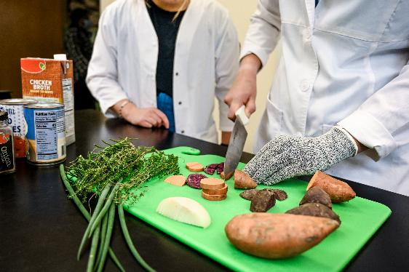
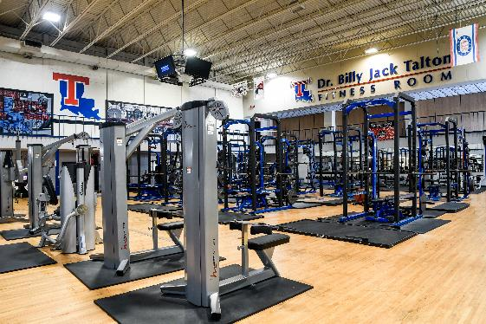
TAKING CARE OF YOURSELF
Get adequate rest (at least 8 Hours) to help avoid problems like sickness, stress, and depression.
Good nutrition is crucial to avoiding feel and perform your best.
Regular exercise is a important in maintain health and reduce the risk of disease and injury.

Slide 28
MAINTING PHYSICAL HEALTH
THE BALANCING ACT
Eat a diet that is healthy and adequate
Utilize the Good Nutrition Mission Food Pantry
Engage in regular exercise at the Lambright
Educate yourself about drug and alcohol use and maintain a healthy perspective
Practice a regular and healthy sleep pattern
Understand and practice health behaviors related to sexual and romantic relationships
Maintain regular doctor and dentist appointments
Consult the medical professionals at the TechCare Student Health Center as needed.

